Slide 1
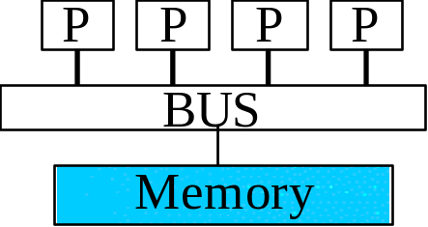
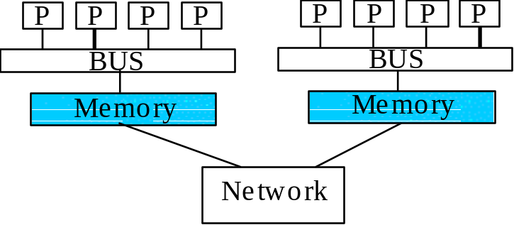
Shared Memory: UMA and NUMA
Uniform memory access (UMA)
Each processor has uniform access time
to memory - also known as
symmetric multiprocessors (SMPs)
(example: SUN ES1000)
Non-uniform memory access (NUMA)
Time for memory access depends on
location of data; also known as Distributed
Shared memory machines. Local access is faster
than non-local access. Easier to scale
than SMPs
(example: SGI Origin 2000)

Slide 2
SMPs: Memory Access Problems
Conventional wisdom is that systems do not scale well
  Bus based systems can become saturated
  Fast large crossbars are expensive

Slide 3
SMPs: Memory Access Problems
Cache Coherence : When a processor modifies a shared variable in local cache, different processors have different value of the variable. Several mechanism have been developed for handling the cache coherence problem
Cache coherence problem
  Copies of a variable can be present in multiple caches
  A write by one processor may not become visible to others
  They'll keep accessing stale value in their caches
  Need to take actions to ensure visibility or cache coherence

Slide 4
Cache Coherence Problem
Processors see different values for u after event 3
Processes accessing main memory may see very stale value
Unacceptable to programs, and frequent!
P
1
P
2
P
3
u
=
?
u
=
?
u
=
7
$
4
$
5
$
3
u
:
5
u
:
5
1
I
/
O
d
e
v
i
c
e
s
u
:
5
2
M
e
m
o
r
y

Slide 5
Snooping-Based Coherence
Basic idea:
  Transactions on memory are visible to all processors
  Processor or their representatives can snoop (monitor) bus and take action on relevant events
Implementation
  When a processor writes a value a signal is sent over the bus
  Signal is either
    Write invalidate - tell others cached value is invalid and then update
    Write broadcast/update - tell others the new value continuously as it is updated

Slide 6
SMP Machines
Various Suns such as the E10000/HPC10000
Various Intel and Alpha servers

Slide 7
“Distributed-shared” Memory (cc-NUMA)
Consists of N processors and a global address space
  All processors can see all memory
  Each processor has some amount of local memory
  Access to the memory of other processors is slower
  Cache coherence (‘cc’) must be maintained across the network as well as within nodes
NonUniform Memory Access

Slide 8
cc-NUMA Memory Issues
Easier to build with same number of processors because of slower access to remote memory (crossbars/buses can be less expensive than if all processors are in an SMP box)
Possible to created much larger shared memory system than in SMP
Similar cache problems as SMPs, but coherence must be also enforced across network now!
Code writers should be aware of data distribution
  Load balance
  Minimize access of "far" memory

Slide 9
cc-NUMA Machines
HP X2000, V2500

Slide 10
Distributed Memory
Each of N processors has its own memory
Memory is not shared
Communication occurs using messages
  Communication networks/interconnects
Custom
  Many manufacturers offer custom interconnects
Off the shelf
  Ethernet
  ATM
  FIBER Channel
  FDDI
P
P
P
P
P
P
M
M
M
M
M
M
Network

Slide 11
Multi-tiered/Hybrid Machines
Clustered SMP nodes (‘CLUMPS’): SMPs or even cc-NUMAs connected by an interconnect network
Examples systems
  All new IBM SP
  Sun HPC10000s using multiple nodes
  SGI Origin 2000s when linked together
  HP Exemplar using multiple nodes
  SGI SV1 using multiple nodes

Slide 12
Reasons for Each System
SMPs (Shared memory machine): easy to build, easy to program, good price-performance for small numbers of processors; predictable performance due to UMA
cc-NUMAs (Distributed Shared memory machines) : enables larger number of processors and shared memory address space than SMPs while still being easy to program, but harder and more expensive to build
Distributed memory MPPs and clusters: easy to build and to scale to large numbers or processors, but hard to program and to achieve good performance
Multi-tiered/hybrid/CLUMPS: combines bests (worsts?) of all worlds… but maximum scalability!

